Slide 1
PSCS_162 Capacity building, performance assessment and motivation driven tool for faculty upgradation
CSE7101- Capstone Project
Review-5
Batch Number:
Under the Supervision of,
Mr. Md Ziaur Rahman
Assistant Professor
School of Computer Science and Engineering
Presidency University
Roll Number | Student Name
20221CSE0315 20221CSE0354 20221CSE0327 | G Syed Luqmaan Pavan K C Mohammad Azharuddin B
Name of the Program: Capstone Project
Name of the HoD: Dr Asif Mohammed
Name of the Program Project Coordinator: Dr Jayavadivel Ravi
Name of the School Project Coordinators: Dr. Sampath A K , Dr. Geetha A

Slide 2
Problem Statement Number:
Category: Software
Problem Description: Capacity building, performance assessment and motivation driven tool for faculty upgradation

Slide 3
Content
Problem Statement
Objectives
Background and Related work for title Selection
Analysis of Problem Statement
Innovation or Novel Contributions
Git-hub Link
Timeline of the Project
References

Slide 4
Content (continuation)..
Problem Statement
Objectives
Background and Related work for title Selection
Analysis of Problem Statement
Innovation or Novel Contributions
Git-hub Link
Timeline of the Project
References

Slide 5
Analysis of Problem Statement
Technology Stack Components:
Next js for frontend
Express js for backend and api management
Mongo DB for storage
Node for run time environment
AWS S3 for file storage
AWS SNS for notification service
Custom Email service
Custom video transcoder and HLS
Docker for containerization
Kubernetes for container orchestration
Technology Stack Components:
Redis for efficient caching
Qdrant as vector DB
CI/CD for automatic deployments

Slide 6
Github Link
https://github.com/gsyedluqmaan/cap_LMS_PU

Slide 7
Analysis of Problem Statement
A capacity building, performance assessment, and motivation-driven tool for faculty upgradation focuses on enhancing teaching quality and professional growth. Capacity building ensures faculty gain new skills through structured training and digital tools. Performance assessment provides measurable insights into teaching effectiveness, student engagement, and content delivery, enabling data-driven improvements. The motivation-driven aspect fosters continuous learning by rewarding achievements, recognizing contributions, and offering personalized growth plans. Together, this tool empowers educators to upgrade their skills, align with evolving academic needs, and maintain high teaching standards, ultimately improving student outcomes and strengthening the institution’s overall academic excellence.

Slide 8
Objectives
Enhance Faculty Skills – Provide structured training modules and resources to strengthen teaching and technical competencies.
Assess Performance – Implement data-driven evaluation methods to monitor teaching quality, student outcomes, and engagement.
Personalized Development – Create tailored upskilling plans for each faculty member based on performance insights.
Promote Innovation in Teaching – Encourage adoption of AI-driven and modern pedagogical practices.
Institutional Growth – Align faculty development with institutional goals to raise overall academic standards.

Slide 9
Software and Hardware Requirements
Mongoose
JWT
Postman
Vercel
Github
AWS S3
AWS SNS
AWS Cloud front
AWS cloudwatch
Windows 10/11 or MAC OS ventura+ or ubuntu 22+
Node 20.x+
Git
Docker
Kubernetes
Redis
VS code
Express js
Next js
MongoDB Atlas or Compass

Slide 10
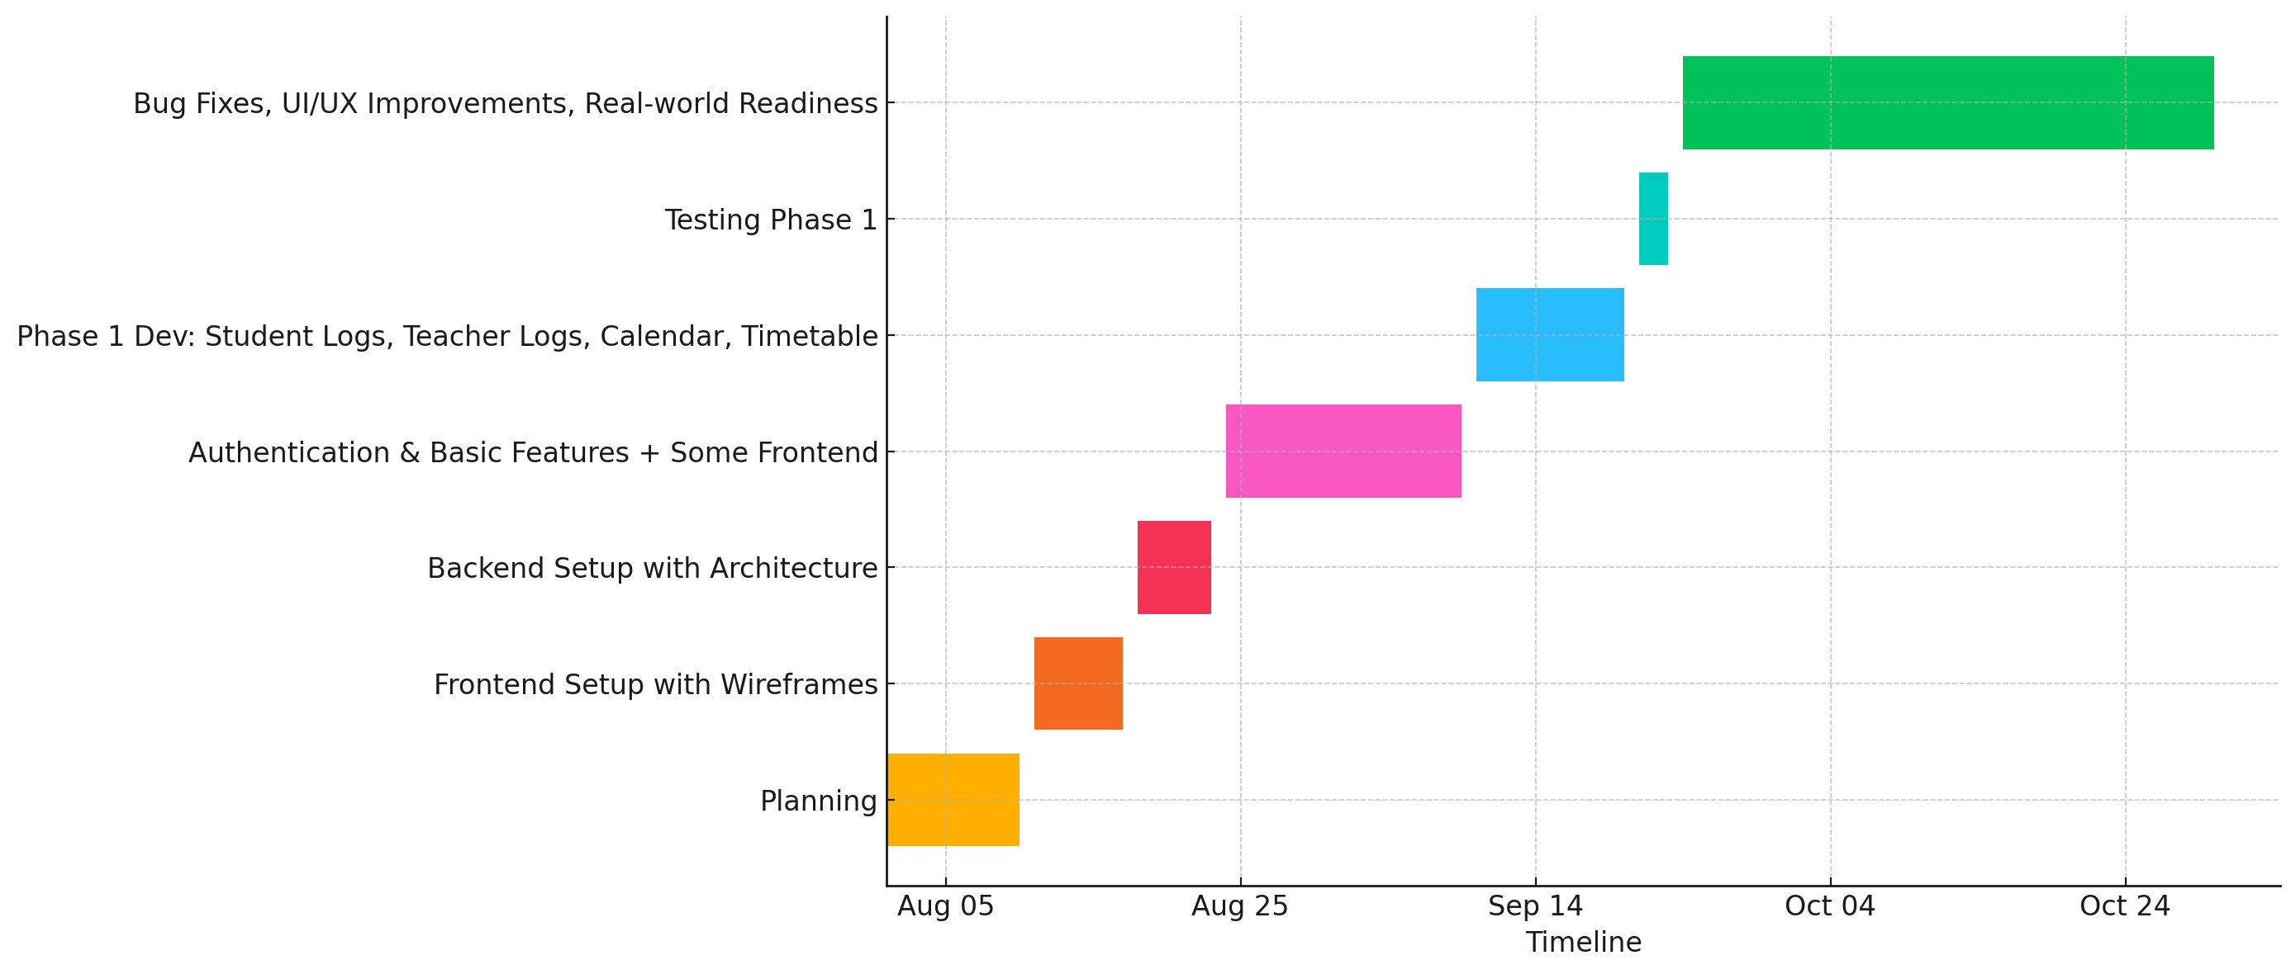
Timeline of the Project (Gantt Chart)

Slide 11
References
[1]. Gyankosh – www.thegyankosh.com – World’s most advanced LMS
[2]. Moodle - moodle.org
[3]. Next Element - nextelement.in

Slide 12


